Slide 1
Where to Stay -In Manhattan

Slide 2
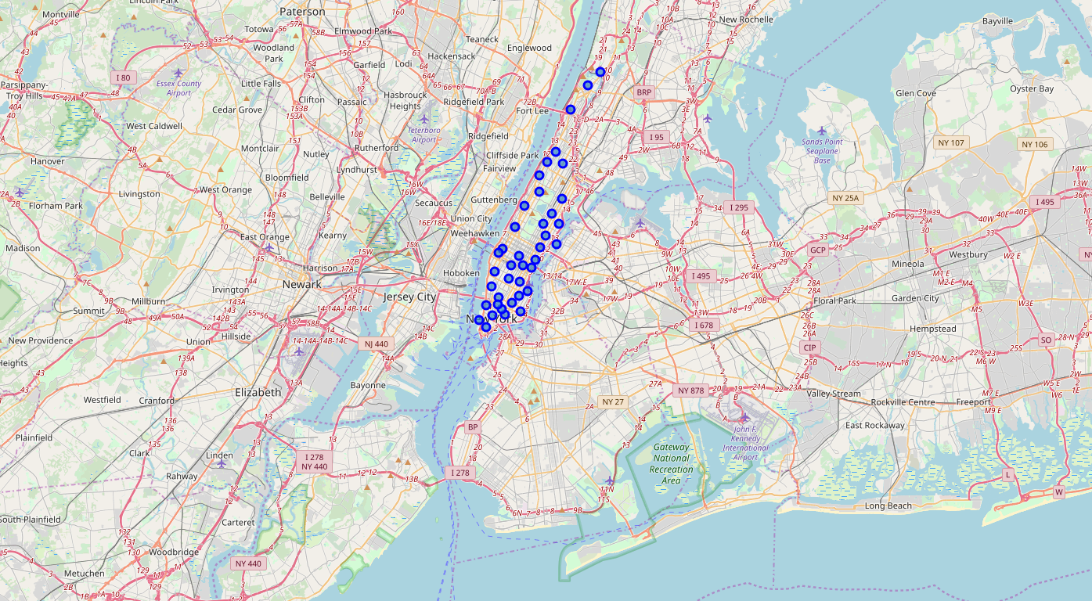
Neighborhood in Manhattan

Slide 3
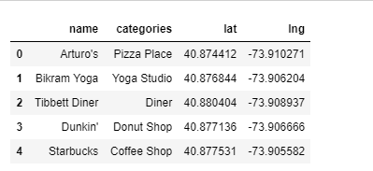
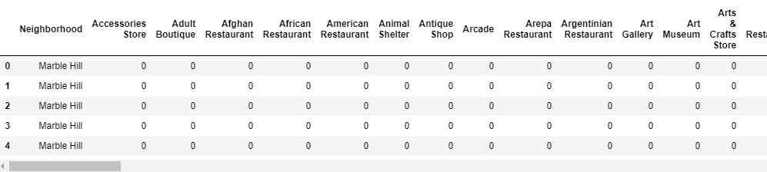
Venues in Manhattan - Foursquare

Slide 4
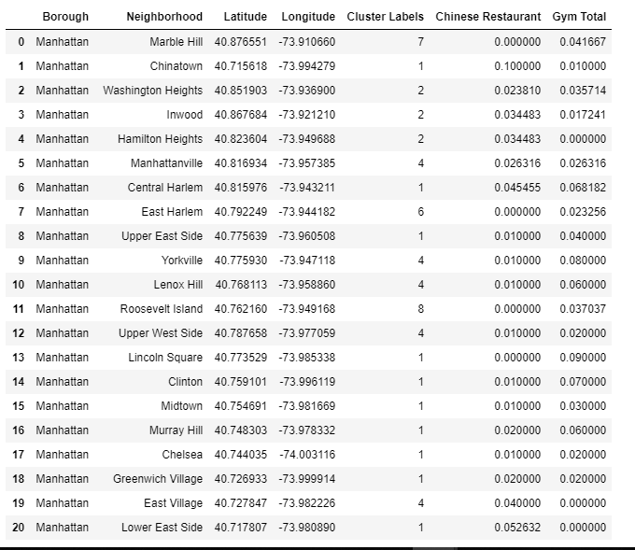
What do you need?
Chinese Restaurant
Gym

Slide 5
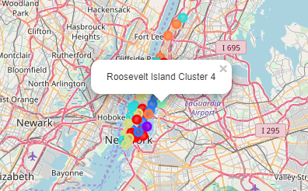
So…. Where to stay?
Roosevelt IS YOUR CHOICE!

